Slide 1

File Handling

Slide 2
INDEX
Introduction
Data Hierarchy
Files and Streams
Creating a sequential-access file
File modes
Functions associated with File
Creating a sequential-access file
Reading a sequential-access file
Updating a sequential-access file
Working with directories
Random access file
Command line arguments

Slide 3
INTRODUCTION
Files provide long-term retention of large amounts of data
Persistent data maintained in files
Files stored on secondary storage devices, such as magnetic disks, optical disks and tapes

Slide 4
DATA HIERARCHY
Data items processed by computers form data hierarchy in which data items become larger, more complex in structure in progression from bits to bytes to characters to fields, etc.
Smallest computer-supported data item bit (short for “binary digit”) either 0 or 1
1 byte = 8 bits
Preferable to program with characters (digits, letters and special symbols)
Fields composed of characters (or bytes)
Record (typically, tuple, dictionary or instance) composed of several fields.
File: group of related records
Record key distinguishes individual records

Slide 5
DATA HIERARCHY
Sally
Black
Tom
Blue
Judy
Green
File
Iris
Orange
Randy
Red
Judy
Green
Record
J u d y Field
01001010 Byte (ASCII character J)
1 Bit

Slide 6
FILES AND STREAMS
Python views files as sequential streams of bytes
Each file ends with an end-of-file marker or a specific byte number recorded in system-maintained administrative data structure
Opening a file creates an object associated with a stream
Three file streams created when Python program executes – sys.stdin (standard input stream), sys.stdout (standard output stream) and sys.stderr (standard error stream)

Slide 7
FILE AND STREAMS
        Python’s view of a file n bytes
0
1
2
3
4
5
6
7
8
9
...
n-1
...
end-of-file marker

Slide 8
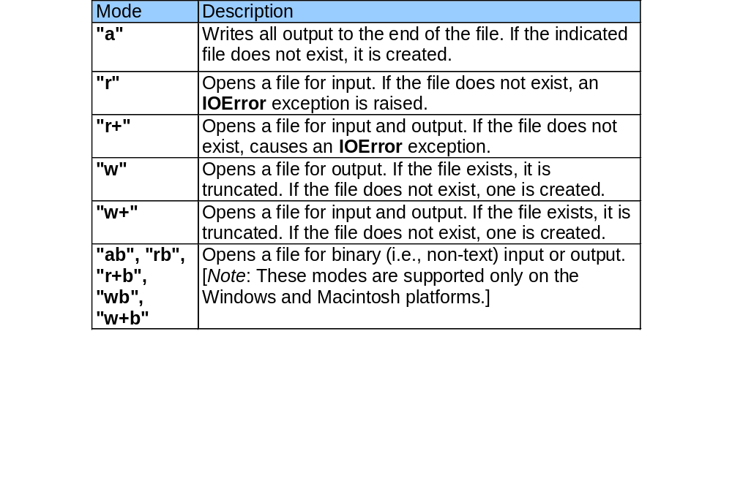
FILE MODES

Slide 9
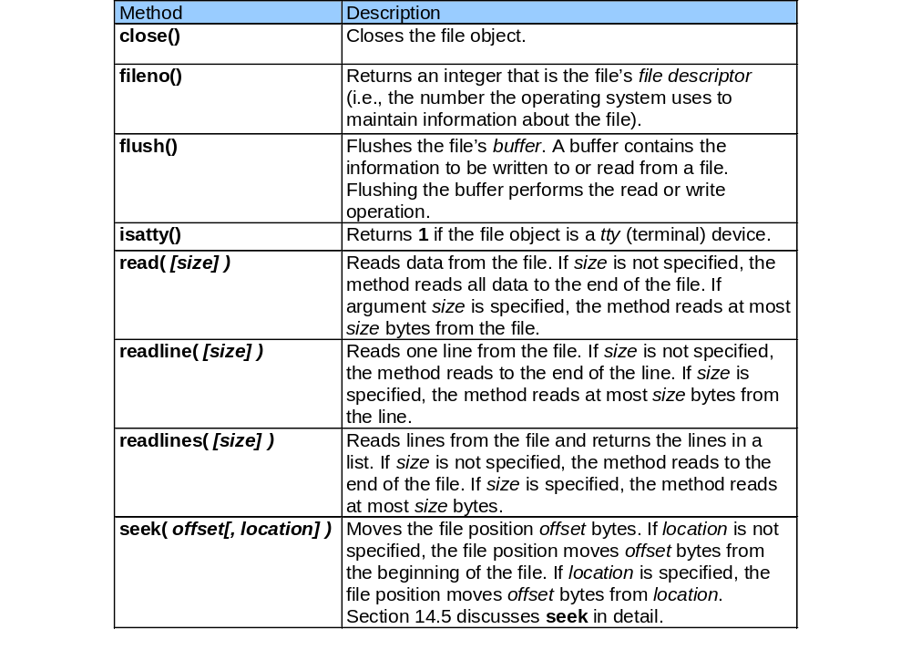
FUNCTIONS ASSOCIATED WITH FILE

Slide 10
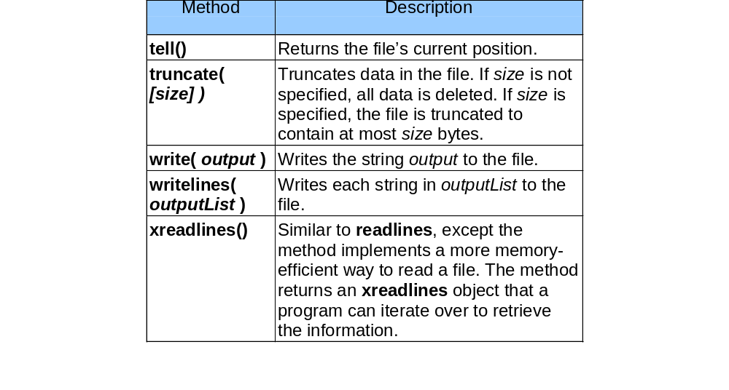
FUNCTIONS ASSOCIATED WITH FILE

Slide 11
CREATING A SEQUENTIAL-ACCESS FILE
1 # Fig. 14.3: fig14_03.py
2 # Opening and writing to a file.
3
4 import sys
5
6 # open file
7 try:
8 file = open( "clients.dat", "w" ) # open file in write mode
9 except IOError, message: # file open failed
10 print >> sys.stderr, "File could not be opened:", message
11 sys.exit( 1 )
12
13 print "Enter the account, name and balance."
14 print "Enter end-of-file to end input."
15
16 while 1:
17
18 try:
19 accountLine = raw_input( "? " ) # get account entry
20 except EOFError:
21 break # user entered EOF
22 else:
23 print >> file, accountLine # write entry to file
24
25 file.close()
Open “clients.dat” in write mode
Function open raises IOError exception if error
encountered
EOFError generated when user enters EOF character
Close file

Slide 12
CREATING A SEQUENTIAL-ACCESS FILE
Enter the account, name and balance.
Enter end-of-file to end input.
? 100 Jones 24.98
? 200 Doe 345.67
? 300 White 0.00
? 400 Stone -42.16
? 500 Rich 224.62
? ^Z

Slide 13
READING A SEQUENTIAL-ACCESS FILE
1 # Fig. 14.6: fig14_06.py
2 # Reading and printing a file.
3
4 import sys
5
6 # open file
7 try:
8 file = open( "clients.dat", "r" )
9 except IOError:
10 print >> sys.stderr, "File could not be opened"
11 sys.exit( 1 )
12
13 records = file.readlines() # retrieve list of lines in file
14
15 print "Account".ljust( 10 ),
16 print "Name".ljust( 10 ),
17 print "Balance".rjust( 10 )
18
19 for record in records: # format each line
20 fields = record.split()
21 print fields[ 0 ].ljust( 10 ),
22 print fields[ 1 ].ljust( 10 ),
23 print fields[ 2 ].rjust( 10 )
24
25 file.close()
Create list of file lines
Format information in each line for output

Slide 14
READING A SEQUENTIAL-ACCESS FILE
Account Name Balance
100 Jones 24.98
200 Doe 345.67
300 White 0.00
400 Stone -42.16
500 Rich 224.62

Slide 15
MODIFYING CONTENT IN A FILE
Sequential-access file data cannot be modified without risk of destroying other data
Copy the content from a file using read and modify the contents in a program and write a new content into a file.

Slide 16
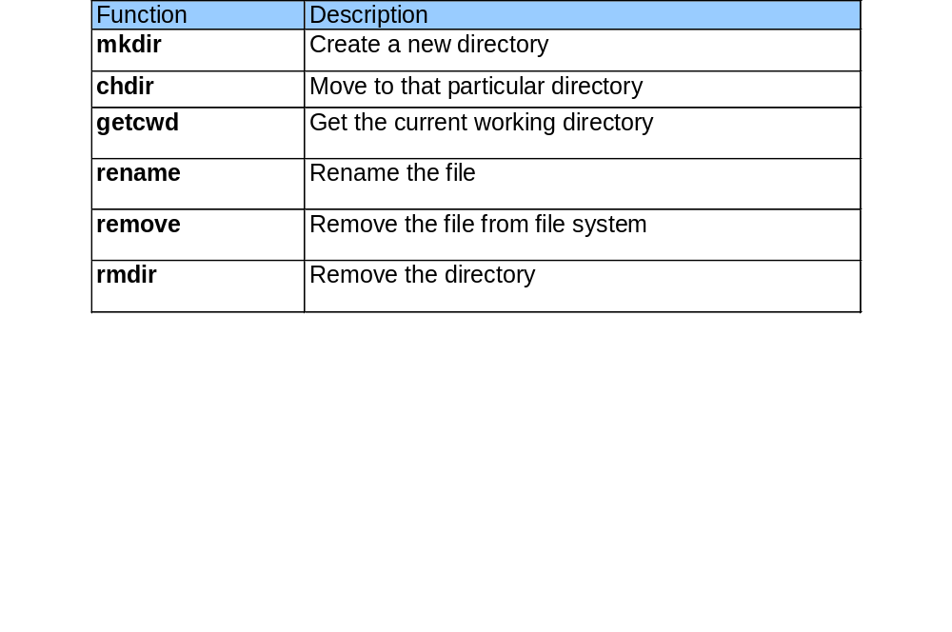
WORKING WITH DIRECTORIES
OS module has function to work with directories.

Slide 17
COMMAND-LINE ARGUMENTS
Arguments will be passed to python program from command line
It will be stored in sys.argv.
Program name will be the first value in the array.
To calculate the length of the command line arguments,
len(sys.argv)
Getopts and OptionParser module can be used to parse the command line option with validation while parsing.

Slide 18
SAMPLE PROGRAM
1 # Fig. 14.6: fig14_06.py
2 # Reading and printing a file.
3
4 import sys
5
6 print “Number of arguments: “,len(sys.argv)
7 print “Program Name: “,sys.argv.pop(0)
8 print “Argument list".str(sys.argv)
$ python myprogram.py 1 2 3
Number of arguments: 4
Program Name: myprogram.py
Argument list: 1 2 3

